Slide 1
8051 Microcontroller – Parallel Port Programming
Text Book Referred: Muhammad Ali Mazidi - The 8051 Microcontroller and Embedded Systems

Slide 2
Benefits of C Programming
Compilers produce hex files that is downloaded to ROM of microcontroller
The size of hex file is the main concern
Microcontrollers have limited on-chip ROM
Code space for 8051 is limited to 64K bytes
The reasons for writing programs in C
It is easier and less time consuming to write in C than Assembly
C is easier to modify and update
You can use code available in function libraries
C code is portable to other microcontroller with little of no modification

Slide 3
C data types for 8051
A good understanding of C data types for 8051 can help programmers to create smaller hex files
Unsigned char
Signed char
Unsigned int
Signed int
Sbit (single bit) - sbit keyword allows access to the single bits of the SFR registers
Bit - Bit allows access to single bits of bit-addressable memory spaces 20 – 2FH;
SFR - The SFR (Special Function Register) can be accessed by their names or by their addresses)

Slide 4
Character Data Type
The character data type is the most natural choice
8051 is an 8-bit microcontroller
Unsigned char is an 8-bit data type in the range of 0 – 255 (00 – FFH)
C compilers use the signed char as the default if we do not put the keyword unsigned

Slide 5
Data Types – Signed Char
The signed char is an 8-bit data type
Use the MSB D7 to represent – or +
Give us values from –128 to +127
We should stick with the unsigned char unless the data needs to be represented as signed numbers
temperature

Slide 6
Unsigned int and signed int Data Types
Unsigned int
Signed int
The unsigned int is a 16-bit data type
Takes a value in the range of 0 to 65535 (0000 – FFFFH)
Define 16-bit variables such as memory addresses
Set counter values of more than 256
Since registers and memory accesses are in 8-bit chunks, the misuse of int variables will result in a larger hex file
Signed int is a 16-bit data type
Use the MSB D15 to represent – or +
We have 15 bits for the magnitude of the number from –32768 to +32767

Slide 7
BIT ADDRESSES
Many microprocessors allow program to access registers and I/O ports in byte size only
However, in many applications we need to check a single bit
One unique and powerful feature of the 8051 is single-bit operation
Single-bit instructions allow the programmer to set, clear, move, and complement individual bits of a port, memory, or register
It is registers, RAM, and I/O ports that need to be bit-addressable
ROM, holding program code for execution, is not bit-addressable

Slide 8
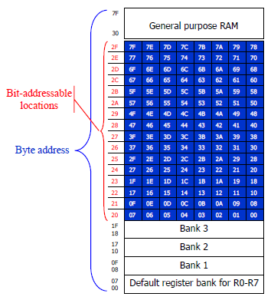
Bit-Addressable RAM
The bit-addressable RAM location are 20H to 2FH
These 16 bytes provide 128 bits of RAM bit-addressability, since 16 × 8 = 128 which is, 0 to 127 (in decimal) or 00 to 7FH
The first byte of internal RAM location 20H has bit address 0 to 7H
The last byte of 2FH has bit address 78H to 7FH
Internal RAM locations 20-2FH are both byte-addressable and bitaddressable
Bit address 00-7FH belong to RAM byte addresses 20-2FH
Bit address 80-F7H belong to SFR P0, P1, …
We can use only the single-bit instructions and these instructions use only direct addressing mode

Slide 9
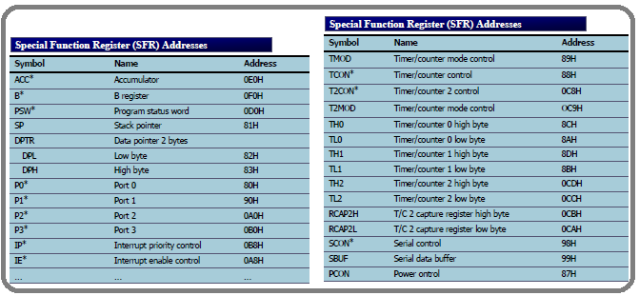
SFR Registers and Their Addresses
The SFR (Special Function Register) can be accessed by their names or by their addresses
The SFR registers have addresses between 80H and FFH
Not all the address space of 80 to FF is used by SFR
The unused locations 80H to FFH are reserved and must not be used by the 8051 programmer

Slide 10
Single Bit, Bit and sfr data types
Single Bit
sbit and sfr
sbit MYBIT=P1^0;
sbit keyword allows access to the single bits of the SFR registers
sbit mybit=P2^4;
Ports P0 – P3 are bit addressable and we use sbit data type to access a single bit of P0 - P3
Use the Px^y format, where x is the port 0, 1, 2, or 3 and y is the bit 0 – 7 of that port
To access the byte-size SFR registers, we use the sfr data type
sfr P0=0x80;
Another way to access the SFR RAM space 80 – FFH is to use the sfr data type
sbit MYBIT=0x95;
We can access a single bit of any SFR if we specify the bit address

Slide 11
Using bit Data Type for Bit-addressable RAM
bit memorybit; //use bit to declare bit- addressable memory
We use bit data type to access data in a bit-addressable section of the data RAM space 20 – 2FH
The bit data type allows access to single bits of bit-addressable memory spaces 20 – 2FH

